Slide 1

IR Models
Structuctred Browsing
Hypertext Model
Std RegNo.: 2021-CS-164

Slide 2
CONTENTS
Introduction
Chosen Application
Content Hierarchy Design
Implementation
Result

Slide 3

IR Models
Introduction
The Structured Browsing Model is designed to organize and present content in a hierarchical structure, enhancing navigation and user experience.

Slide 4
Choosen Application
IR Models
Applications
An online platform where students and educators can browse and explore educational content across various subjects.
Key Concept
Hierarchical navigation for subjects, topics, and subtopics.
Easy-to-use search functionality.
Hyperlinks for navigating related content.
Example
Want to learn Physics? Click to explore topics like Mechanics or Thermodynamics!

Slide 5
Content Hierarchy Design
Content Structure
Subjects (e.g., Mathematics, Science)
Topics (e.g., Algebra, Physics)
Subtopics (e.g., Linear Equations, Mechanics)
Why Hierarchical Structure?
Organizes vast content into manageable categories.
Makes navigation intuitive and structured.
Reduces cognitive load for users by providing logical pathways.
Science → Physics → Mechanics.

Slide 6
Implementation
01
Treeview Navigation
A collapsible menu to display subjects, topics, and subtopics.
Users can expand or collapse categories based on their interests.
02
Hyperlinks
Links within content to navigate to related topics and subtopics.

Slide 7
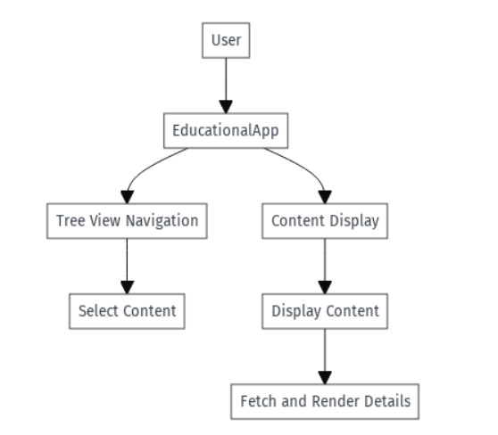
Data Flow Diagram

Slide 8
IR Models
Result
Improved User Navigation
Users could easily browse through subjects, topics, and subtopics without feeling overwhelmed.
Enhanced Learning Experience
Quick access to related content through hyperlinks and search functionality
Positive User Feedback
Users found the platform easy to navigate and appreciated the structured approach to content organization
Example
Students explored Mechanics in 3 clicks, saving time compared to textbooks.
Science → Physics → Mechanics.

Slide 9
Thank You
Std RegNo.: 2021-CS-164

